Slide 1
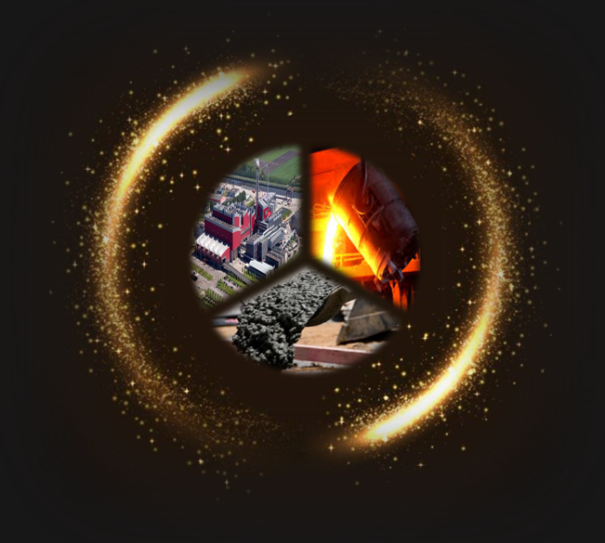
Investigation on the potential application of MSWI bottom ash as cement substitutes
Yubo Sun
Boyu Chen
Shizhe Zhang
Kees Blom
Mladena Luković
Guang Ye
02-04-2019

Slide 2
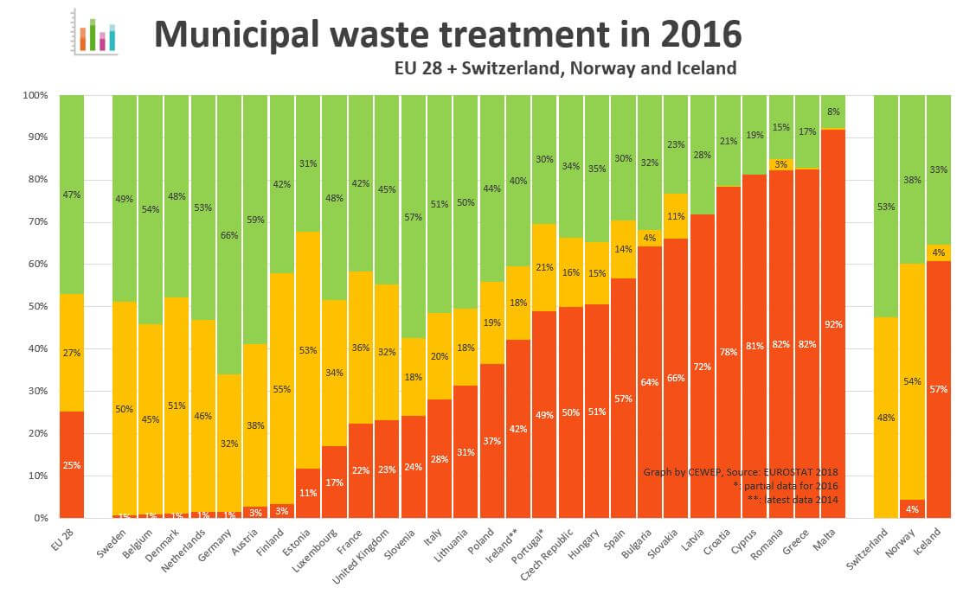
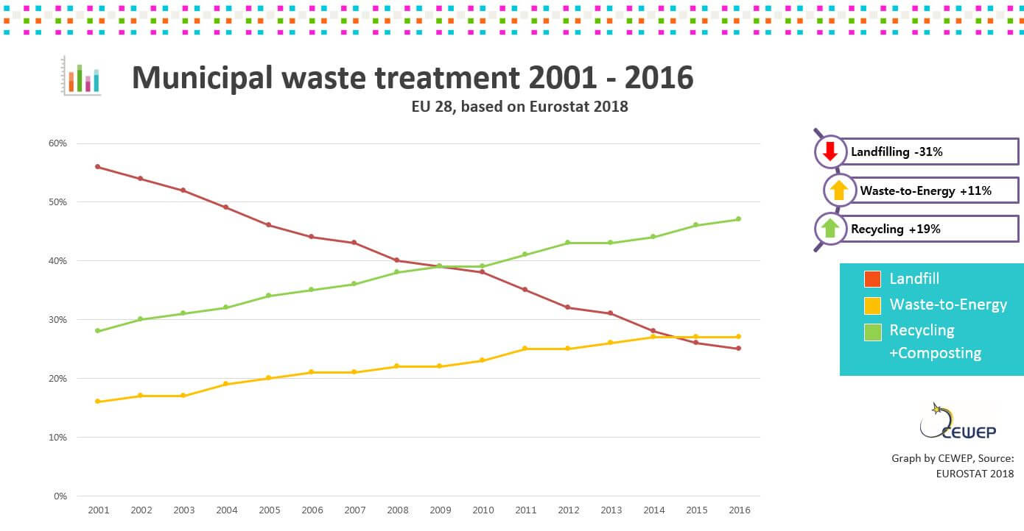
Background
Municipal waste and MSWI BA
Municipal waste treatment
Belgium
Netherlands

Slide 3
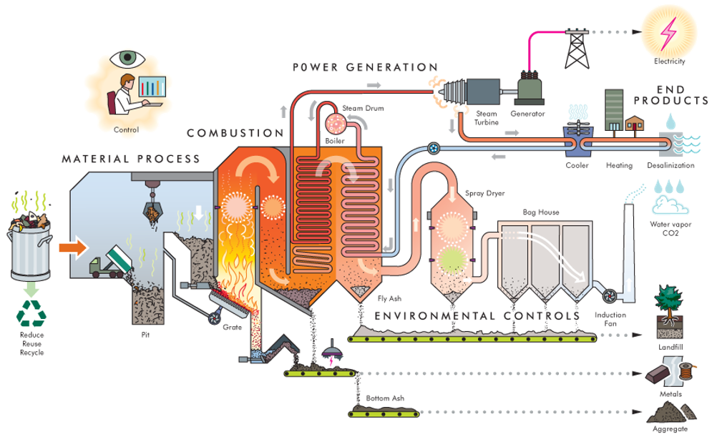
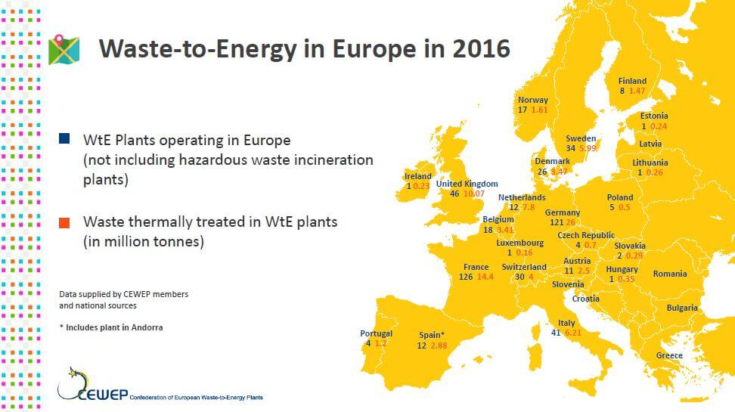
Background
Municipal waste and MSWI BA
Waste to energy
WtE: the energy recovery process of generating energy in the form of electricity or heat through incineration.
Main products:
Fly ash
Bottom ash
Zero-cost raw material
Conservation of resources
Elimination of waste

Slide 4
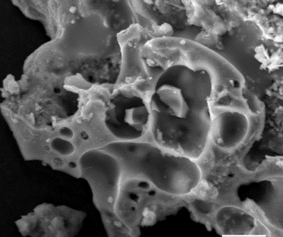
Background
Municipal waste and MSWI BA
MSWI BA
Potential applications:
Aggretate in pavement concrustion
Substitute materials in concrete (cement, filler or aggregate)
Main problems:
Heavy metals:
$Ni$, $Zn$, $Cd$, $Cu$, $Pb$, $Mo$
Harmful salts:
${Cl}^{−}$, ${SO}_{4}^{2−}$
Quartz,
Unburned organics
High-porosity structure
Low reactivity
Metallic aluminum content
Leaching problems

Slide 5
Introduction to this study
Research problem
Investigate the feasibility and effect of using treated BA in concrete system as cement substitute materials.
Objectives
Investigate the effectiveness of mechanical and thermal treatment.
Discover a proper route of pretreatment.
Investigate the compressive strength and hydration heat development of cement paste with treated BA
Evaluate the performance of treated BA as cement substitute material in concrete.

Slide 6
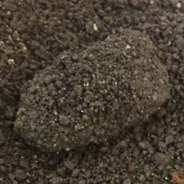
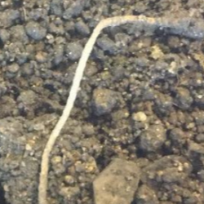
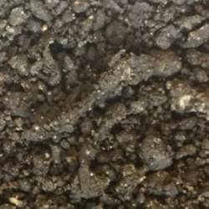
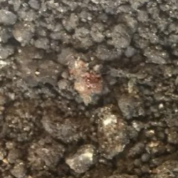
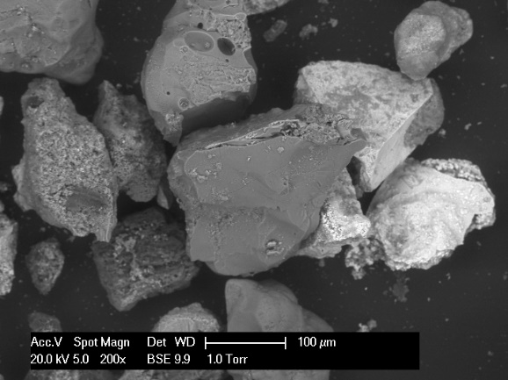
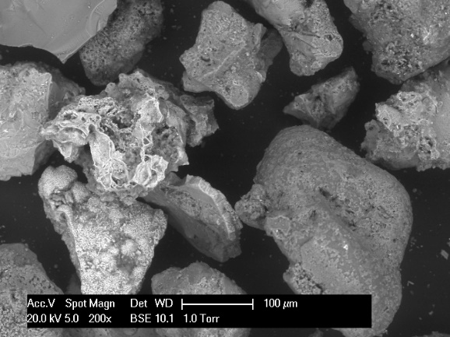
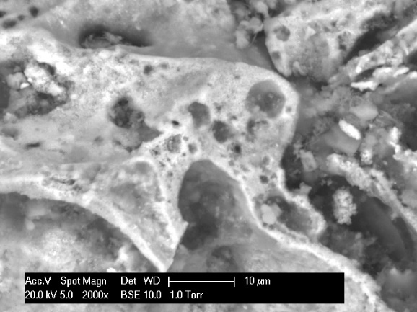
Characterization of as-received BA
As-received BA
Provided by Heros, and a washing process has been performed.
Complex composition
High impurity
Big particle covered with sludge
Metal wire
Tree branch
Brick particle
Unburned organics
Morphology
High-porosity:
Decrese the strength of BA particles.
Absorb extra water so that less water react with cement.

Slide 7
Characterization of as-received BA
Chemical composition
Chemical composition (wt. %) | $$CaO$$ | $$SiO_{2}$$ | $${Fe}_{2}O_{3}$$ | $${Al}_{2}O_{3}$$ | $$MgO$$ | $${Na}_{2}O$$ | $$K_{2}O$$ | $$CuO$$ | $$ZnO$$ | $$P_{2}O_{5}$$ | $${TiO}_{2}$$ | $$Cl$$ | $${SO}_{3}$$ | $$other$$ | $$LOI$$ $$(950℃)$$ | Metallic aluminum
CEM I 42.5N | 64.99 | 17.11 | 3.59 | 3.80 | 1.56 | 0 | 0.16 | 0.02 | 0.15 | 0.63 | 0.27 | 0.02 | 3.96 | 2.01 | 3.10 | -
BA | 22.39 | 43.67 | 12.29 | 11.66 | 2.47 | 0.34 | 0.94 | 0.62 | 0.90 | 0.84 | 1.30 | 0.16 | 1.40 | 1.02 | 7.26 | 0.80
Potential problems and solutions
Metallic aluminum
Chemical/physical treatment
Low reactivity
Thermal treatment
Pretreatment of BA
Unburned organics
Thermal treatment

Slide 8
Pretreatment
Metallic aluminum
Physical treatment
Short time, low speed grinding
Sieving
Metallic aluminum particles are ground into plates and sieved out.
Low reactivity and unburned organics
Thermal treatment
BA samples are heated up to $1000℃$ to generate reactive phases, and unburned organics could be removed as well.

Slide 9
Pretreatment
Flowchart
Thermal treatment
Milling
MTBA
Raw BA
Milling
Sieving
MBA
Substitute materials
MBA (milled bottom ash): A physical treatment which is a combination of grinding (with a planetary ball miller at low speed) and sieving (fine powder was separated by a 63 $μm$ sieve).
MTBA (milled and thermally treated bottom ash): MBA was further activated by heating up to $1000℃$ in a ventilated furnace for 2h, and then cooling down to room temperature.
M300 (pure silica sand): Pure sand without reactivity was selected as a reference material.

Slide 10
Characterization of treated BA
Chemical compositions
Chemical composition (wt. %) | CEM I 42.5N | Raw BA | MBA | MTBA
$$CaO$$ | 64.99 | 22.39 | 18.34 | 18.70
$$SiO_{2}$$ | 17.11 | 43.67 | 50.40 | 43.67
$${Fe}_{2}O_{3}$$ | 3.59 | 12.29 | 12.94 | 13.62
$${Al}_{2}O_{3}$$ | 3.80 | 11.66 | 9.84 | 10.08
$$MgO$$ | 1.56 | 2.47 | 2.21 | 2.40
$${Na}_{2}O$$ | 0 | 0.34 | 0.56 | 0.92
$$K_{2}O$$ | 0.16 | 0.94 | 0.82 | 0.82
$$CuO$$ | 0.02 | 0.62 | 0.48 | 0.48
$$ZnO$$ | 0.15 | 0.90 | 0.75 | 0.77
$$P_{2}O_{5}$$ | 0.63 | 0.84 | 0.67 | 0.74
$${TiO}_{2}$$ | 0.27 | 1.30 | 1.12 | 1.20
$$Cl$$ | 0.02 | 0.16 | 0.12 | 0.03
$${SO}_{3}$$ | 3.96 | 1.40 | 0.86 | 0.84
other | 2.01 | 1.02 | 0.89 | 0.96
 | 3.10
 | -
LOI ($950℃$)
7.26
7.14
0.43
Metallic aluminum content
$$0.80±0.03$$
$$0.13±0.03$$
$$0.06±0.04$$

Slide 11
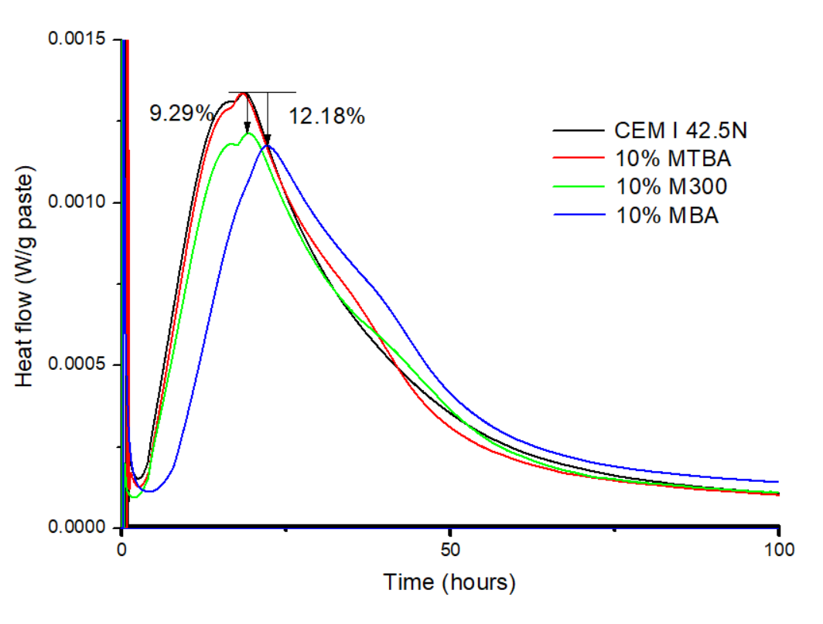
Investigation on paste level
Hydration heat development
Heat flow
MTBA showed stronger exothermic reaction than M300, and the heat flow is almost identical to that of pure cement.
A delay and decrement was observed in the highest heat flow with the addition of MBA.
The retardation effect was eliminated by thermal treatment comparing between MTBA and MBA.

Slide 12
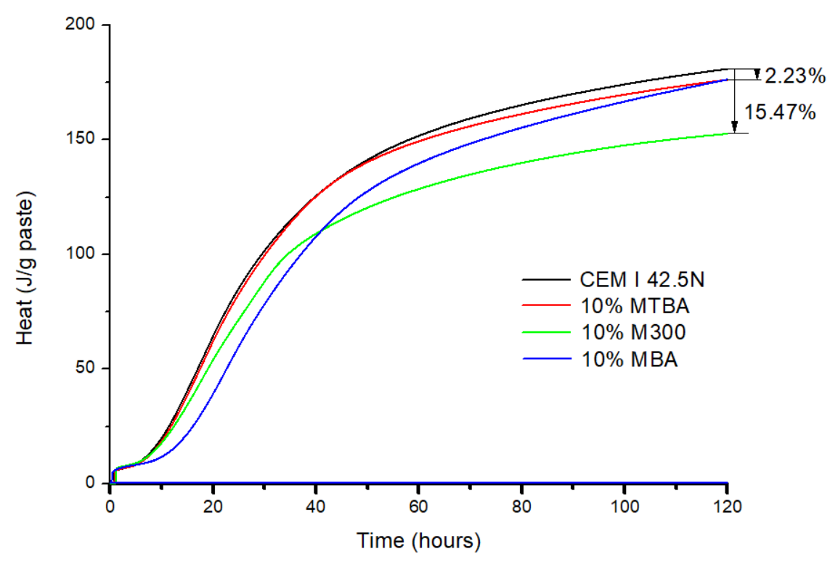
Investigation on paste level
Hydration heat development
Cumulative heat
In MBA, the heat development before 40 hours is even lower than that of M300.
A reversal in heat development trend was observed that the total heat generated in MBA is higher than M300 at the end.
Thermal treatment activated BA samples and mainly contribute to the early-stage heat development.

Slide 13
Investigation on paste level
Compressive strength of paste
Reference M300: Pure sand with no reactivity.
The highest: pure cement
The lowest: 10% CBA
Performance: MTBA>MBA>M300>CBA

Slide 14
Conclusions
The mechanical treatment is effective in removing the metallic aluminum content in BA, and the remaining metallic aluminum could be further removed by oxidation through thermal treatment.
According to the results of compressive strength and hydration heat, both MBA and MTBA works better than pure sand, which proves the contribution of BA to the hydration process. The difference between MBA and MTBA indicates that thermal treatment could increase the reactivity of BA particles.
The result of this study also indicates that MBA is already good enough to be used as filler substitute material in concrete since the 7-day and 28-day compressive strength of mortar strength with 10% MBA is higher than that with same amount of M300.

Slide 15
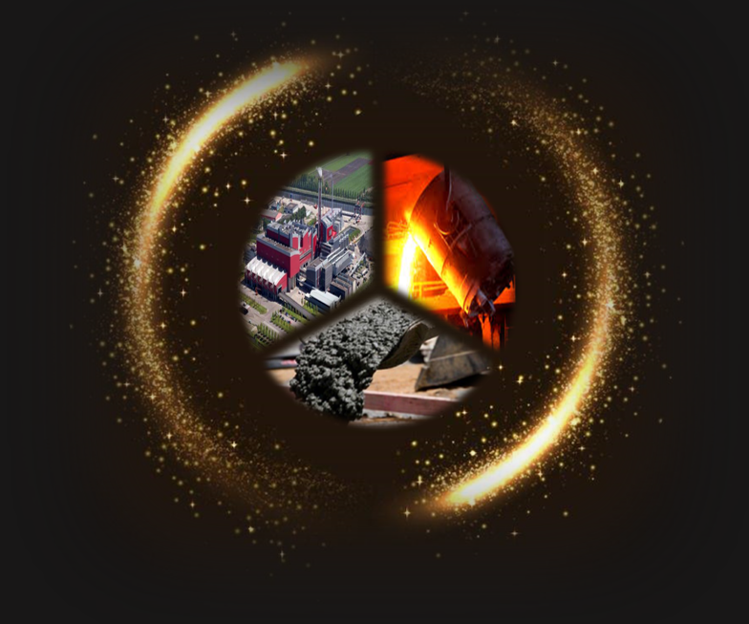
Thank you!

